Slide 1
Text Clustering
Presented to:
Prof. Arya
Team Member:
Alaa Abdullah Naser Mousa
Noha Fahem Sara Abdelazim

Slide 2
Our Agenda
01
02
03
04
Loading Data
Data Preprocessing and Cleaning
Word Embedding
Clustering
05
Evaluation
06
Error Analysis

Slide 3
01
Loading Data

Slide 4
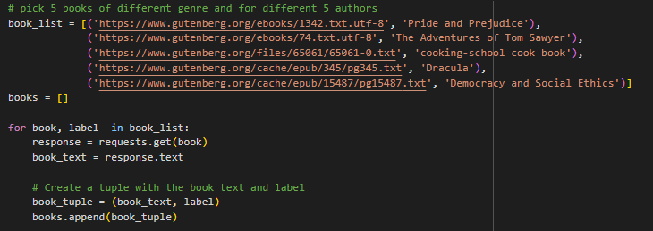
Loading Data
We loaded our data as shown in this block of code. The list of books is specified in a separate list of tuples called book_list. Each tuple in book_list contains a URL that points to the text file of a book and a string label that identifies the book.

Slide 5
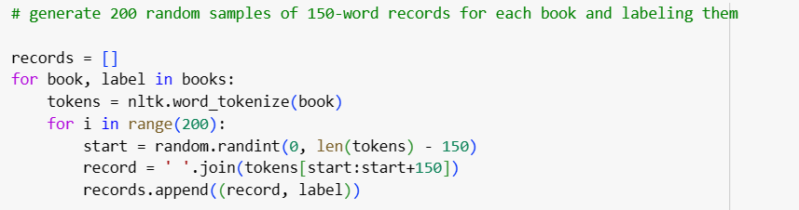
Creating partitions of data
As required to generate 200 random samples of 150 words for each book. We iterated through the books as we know from the snippet above it’s a tuple containing book text and its title.

Slide 6
02
Data Preprocessing and Cleaning

Slide 7
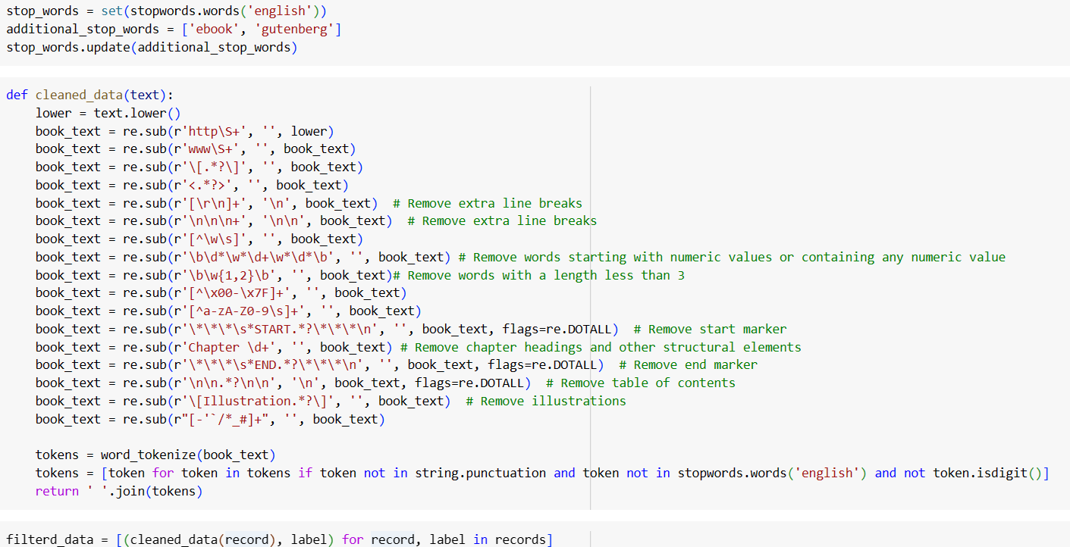
Data Cleaning
We added some additional words to the stopwords list that we thought we can safely remove as they are not useful for our case. Then there is our cleaned_data function that takes in a single parameter, text, which is a string containing text data.

Slide 8

Converting to dataframe
We converted our data to dataframe as it's easier to work with in cases such as analysis, manipulation, filtering, and etc. And we give proper names to columns instead just the default 0 and 1

Slide 9
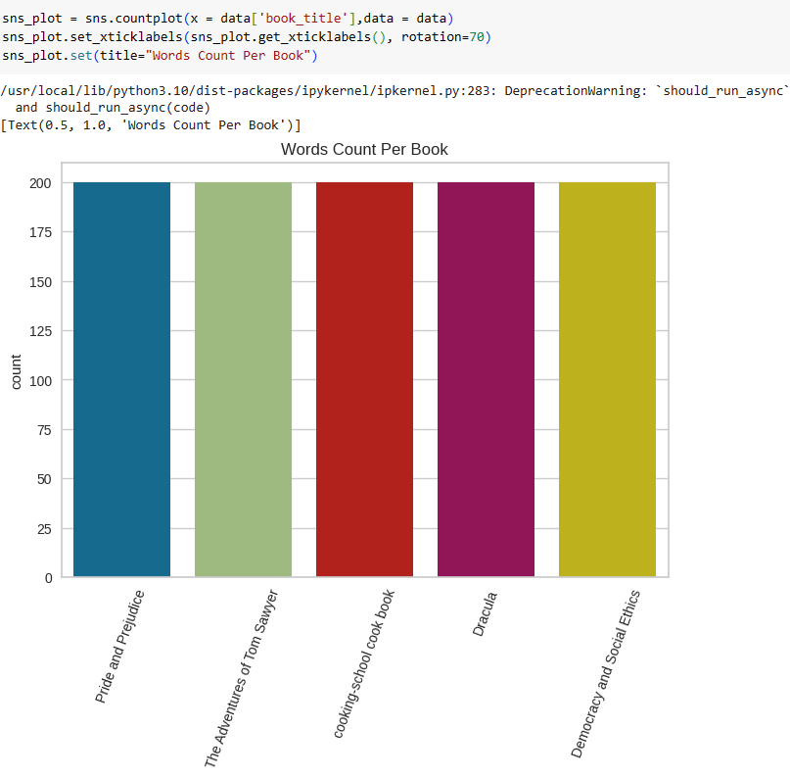

Slide 10
03
Word Embedding as some call it transformation

Slide 11
We use BoW, TF-IDF and LDA

Slide 12
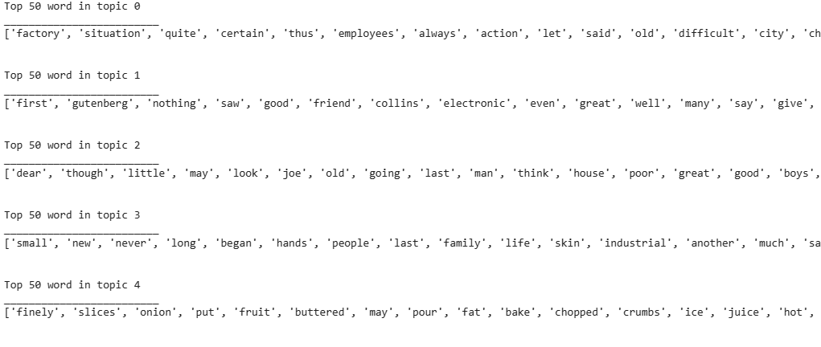
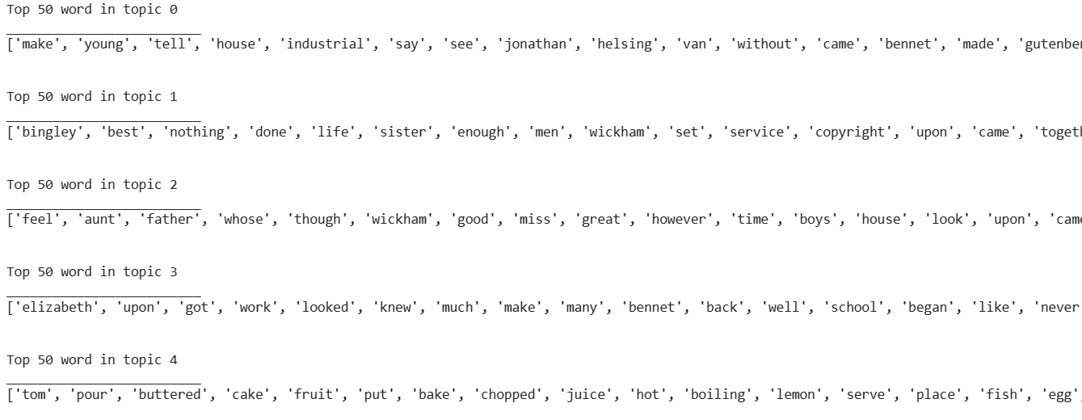
Overview of data using LDA.
LDA is a technique that helps you find the main topics in a set of documents. It works by looking at the words that appear in the documents and grouping them into topics based on how frequently they appear together.
This was the output for BoW
This was the output for TF-IDF

Slide 13
TSNE Visualization

Slide 14
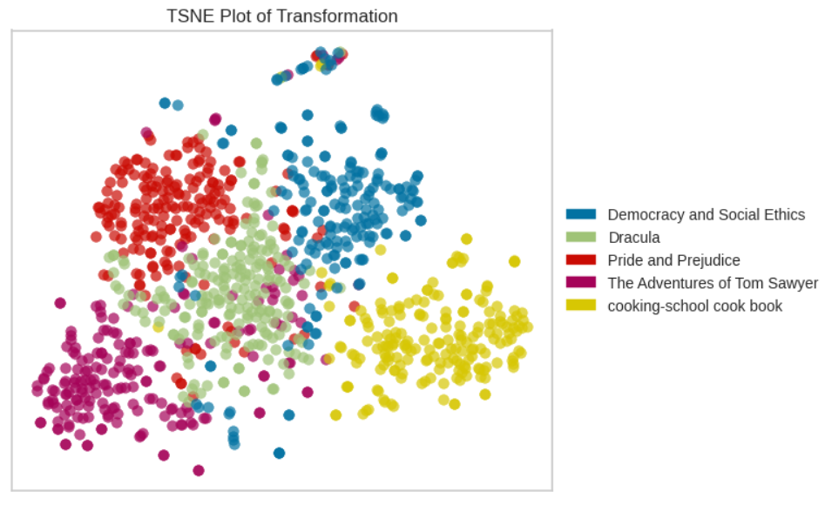
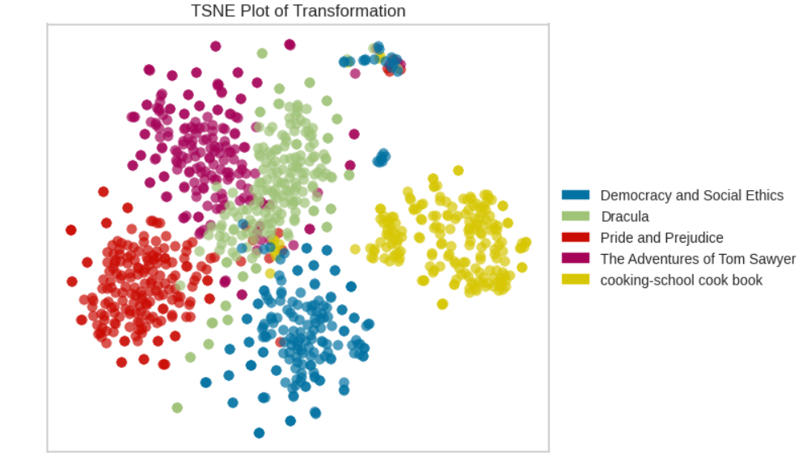
On BoW
On TF-IDF

Slide 15
04
Clustering

Slide 16
We used Kmeans, Agglomerative Clustering, and EM

Slide 17
K-means

Slide 18
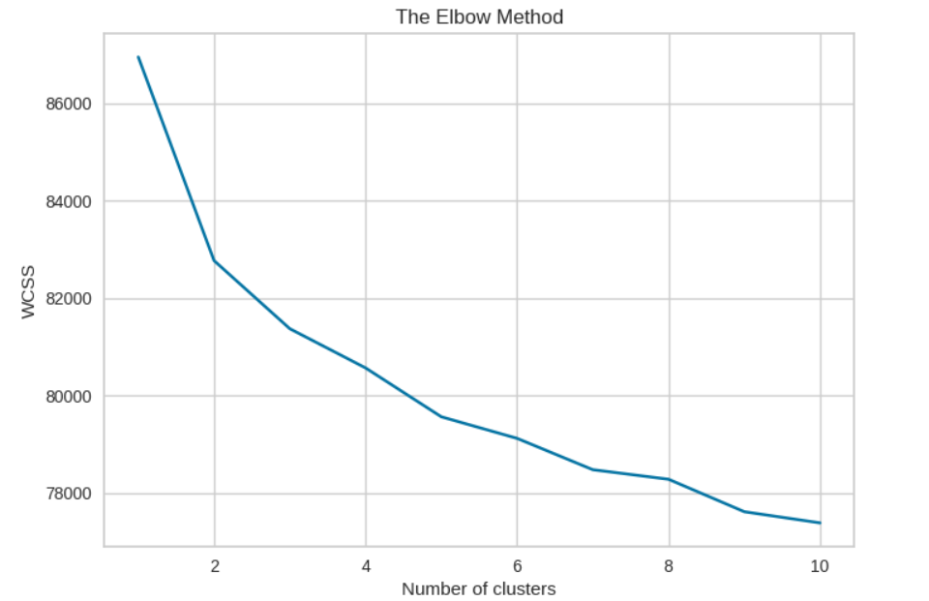
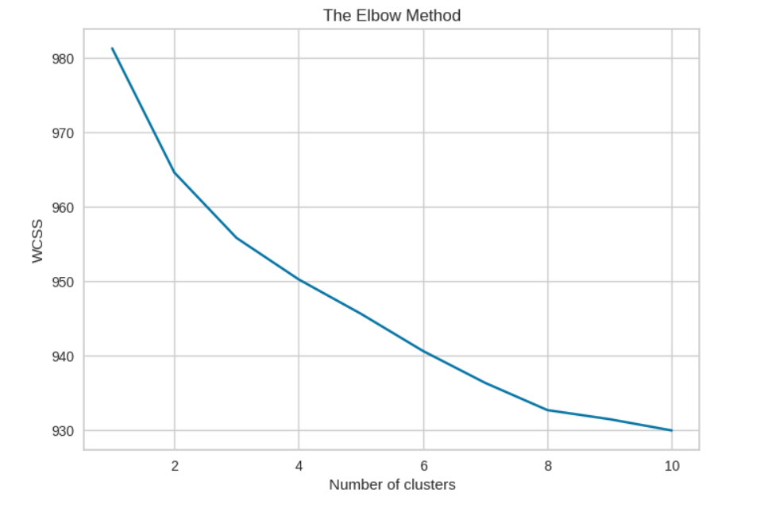
Elbow Method
On BoW
On TF-IDF

Slide 19
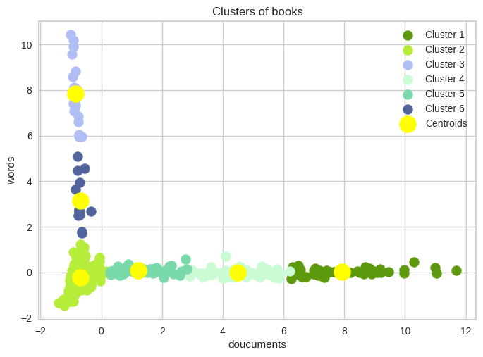
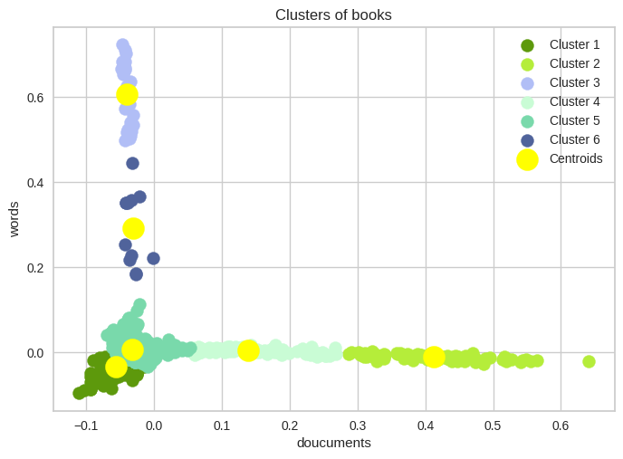
Visualizing the clusters
On BoW
On TF-IDF

Slide 20
Agglomerative Hierarchical Clustering

Slide 21
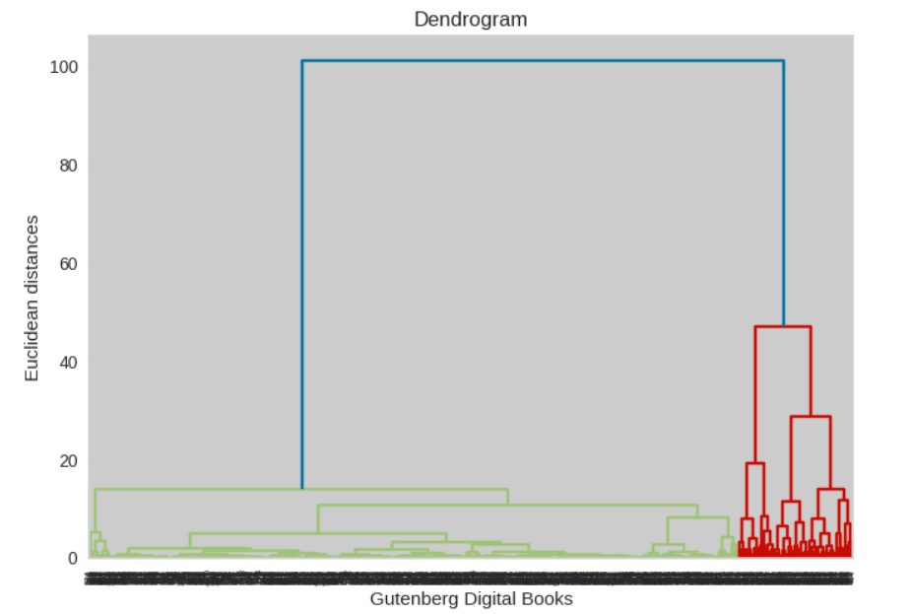
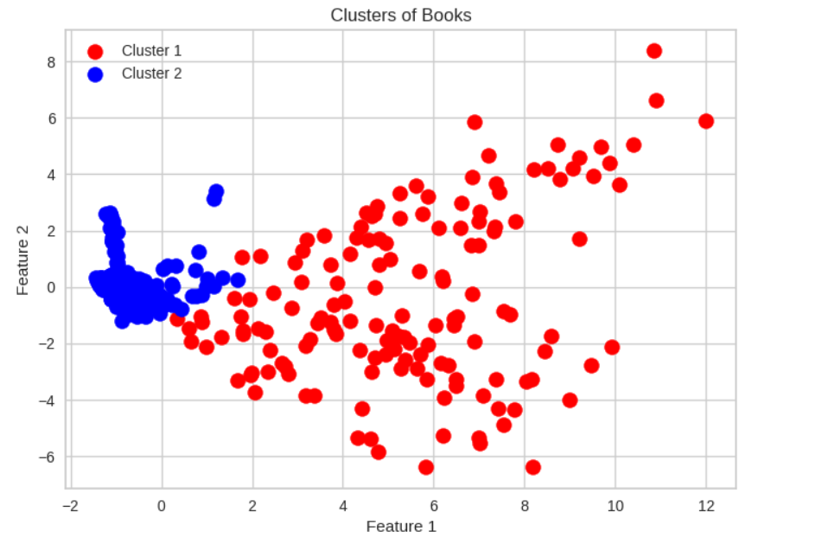
bow

Slide 22
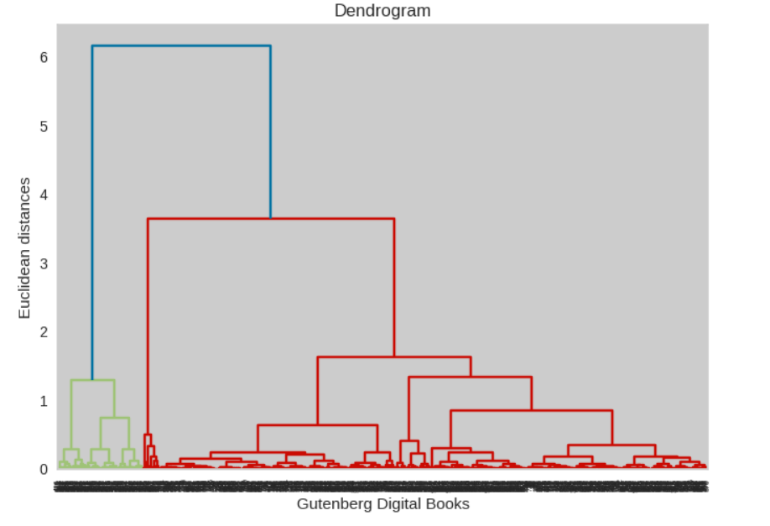
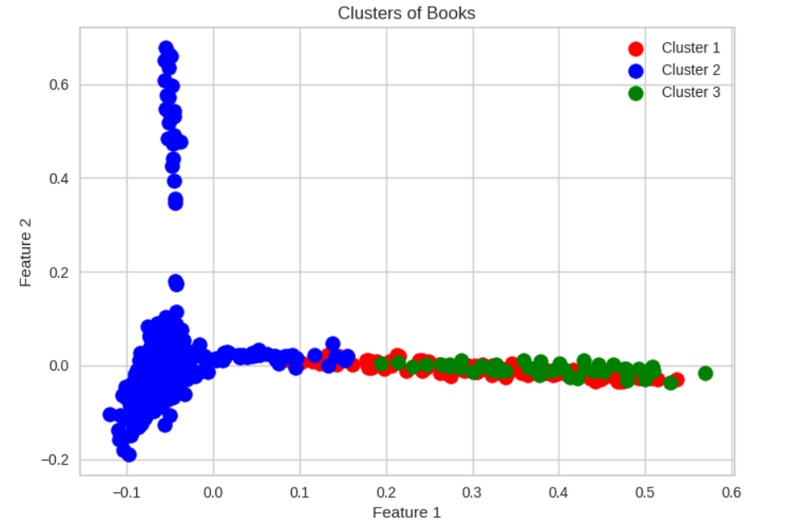
TF-IDF
TF-IDF

Slide 23
EM Clustering

Slide 24
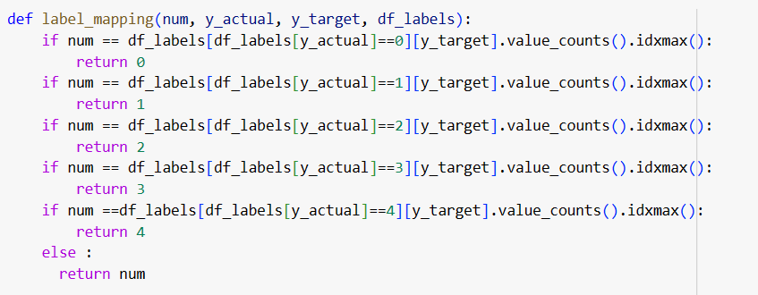
We used this function to map the labels based on the maximum occurrences for each category.

Slide 25
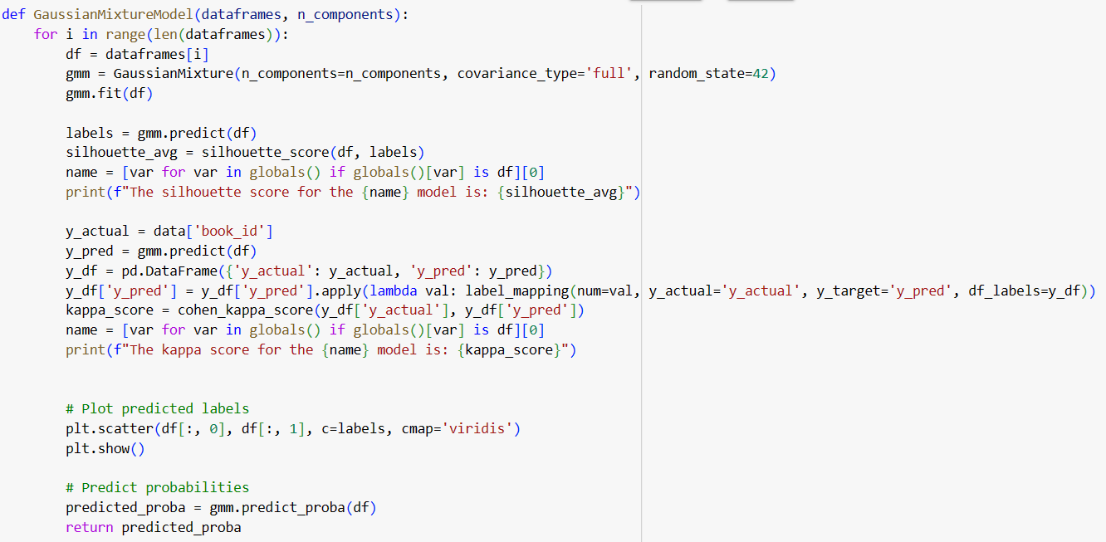
Then applied the Gaussian

Slide 26
We first experimented with 6 clusters

Slide 27
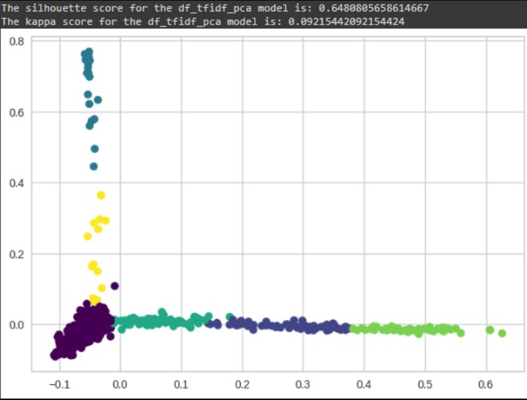
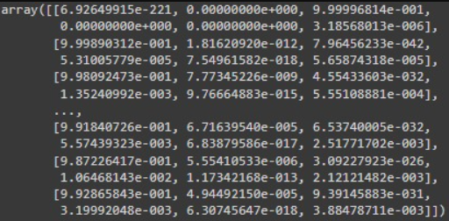
TF-IDF with PCA

Slide 28
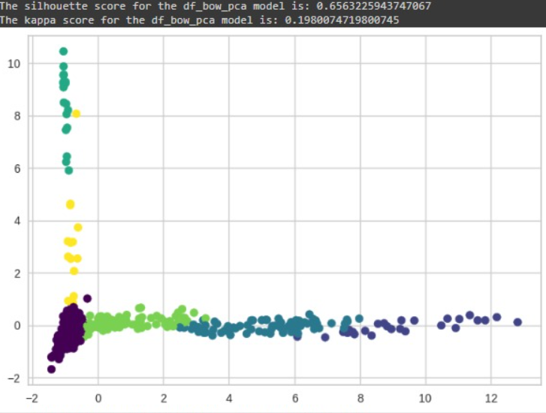
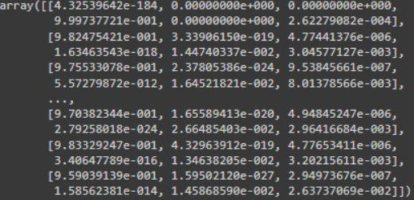
BoW with PCA

Slide 29
We first experimented with 9 clusters

Slide 30
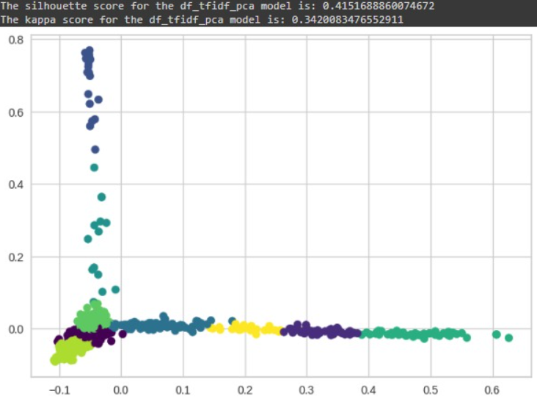
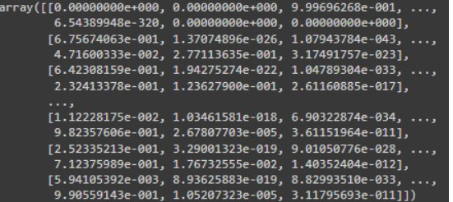
TF-IDF with PCA

Slide 31
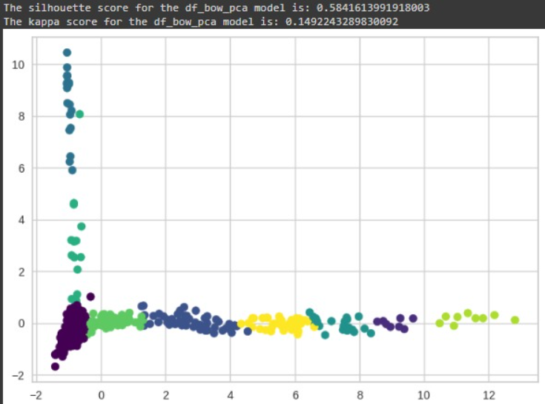
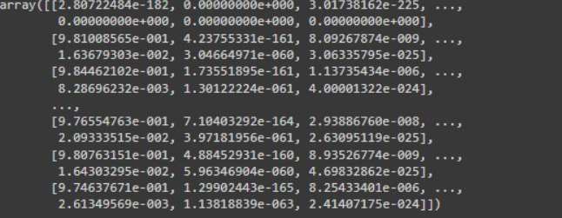
BoW with PCA

Slide 32
05
Evaluation

Slide 33
We measure coherence

Slide 34
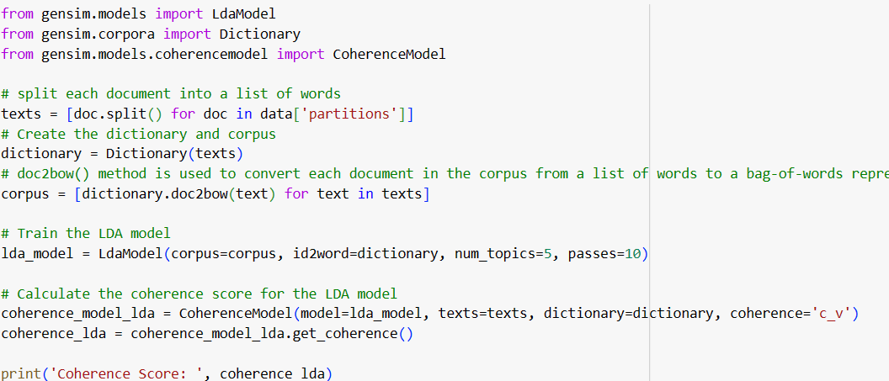

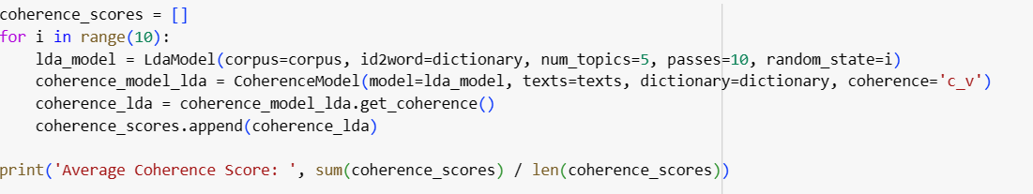

calculating coherence

Slide 35
Our champion model: Agglomerative hierarchical clustering with BoW

Slide 36
06
Error Analysis

Slide 37
We measure silhouette, and kappa

Slide 38



K-means clustering
→For BOW using PCA
6 clusters, the score was
→For TF-IDF
8 clusters, the score was,

Slide 39


K-means clustering con’t
→Kappa with 6 clusters for both representatives
For BOW, the score was
For TF-IDF the score was

Slide 40


Agglomerative Clustering
2 clusters, the score was
3 clusters, the score was

Slide 41




Agglomerative Clustering Con’t
→With 6 clusters
For TF-IDF the score was
For BOW, the score was
→With 9 clusters
For TF-IDF the score was
3 clusters, the score was
.

Slide 42
Thank you!
any questions?

